Slide 1

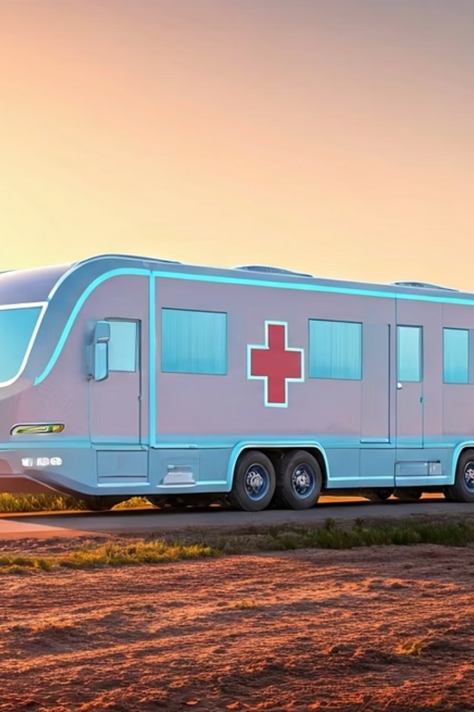
Revolutionizing Healthcare Access Through Advance Innovation
Presented by: [Your Name], Class 11th
Theme: Science & Technology for Sustainable Development
Sub-theme: Transportation & Communication
Notes:
1

Slide 2



“Life is our greatest wealth, and preserving it is our highest duty.”

Slide 3
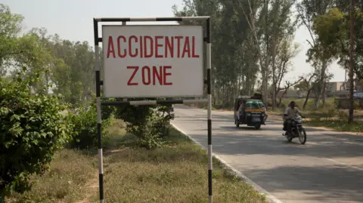
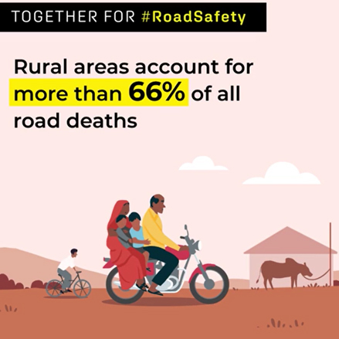
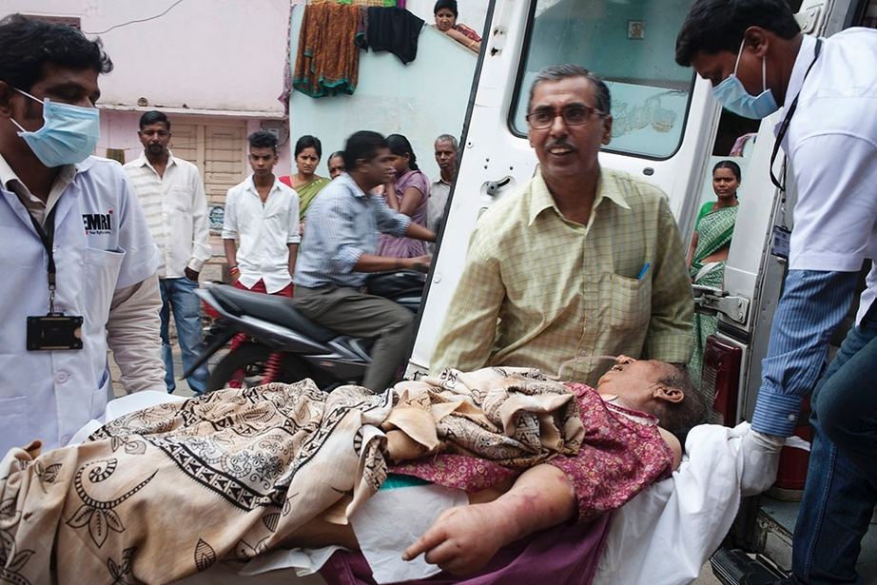

Slide 4

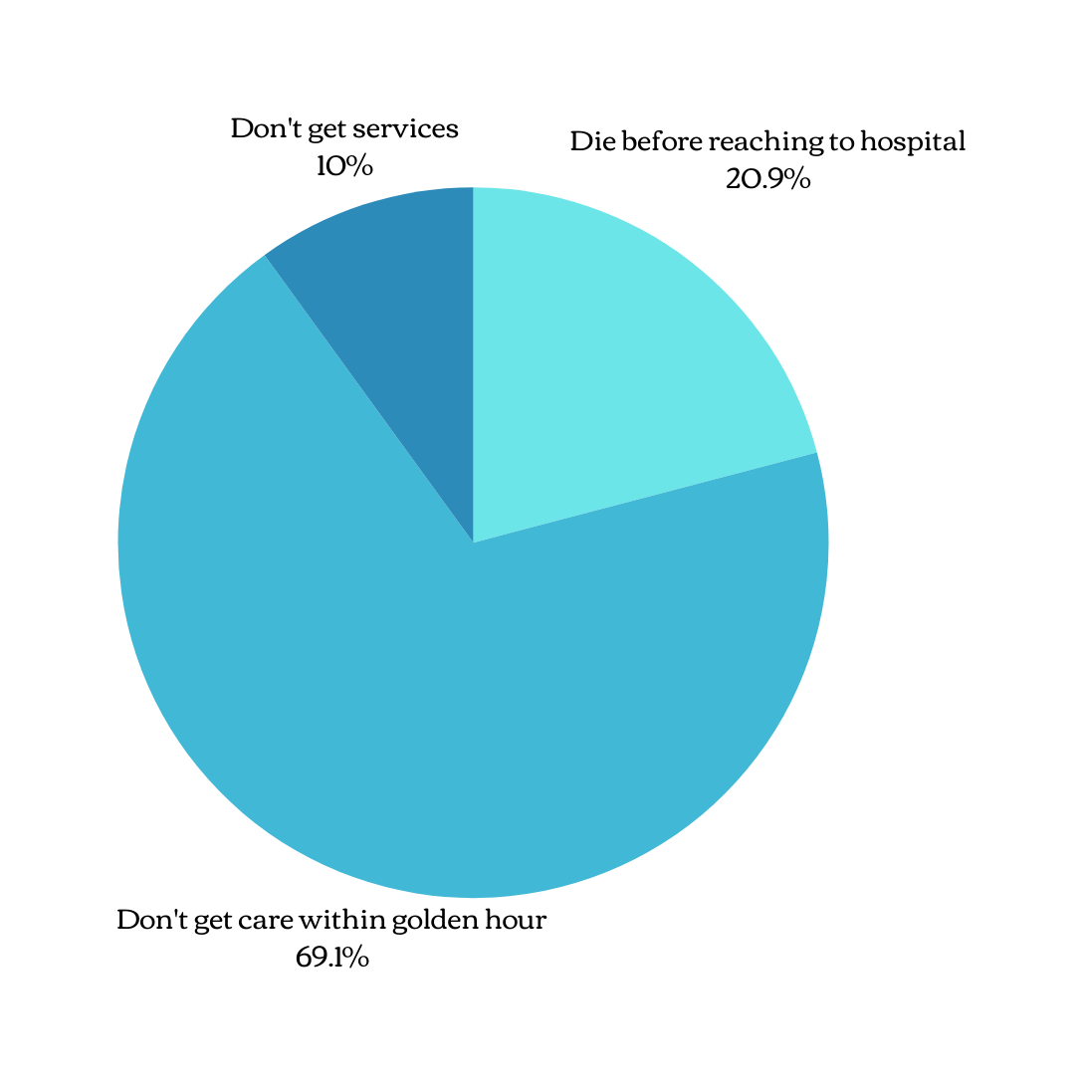

STATISTICS-
Beyond these immediate statistical improvements, 'HOW' has the potential to foster healthier, more productive communities, reducing healthcare expenditures in the long run and contributing to national development. Its success could pave the way for similar mobile units specializing in dental care, eye care, or mental health services, creating a holistic mobile healthcare ecosystem.
Notes:
10

Slide 5
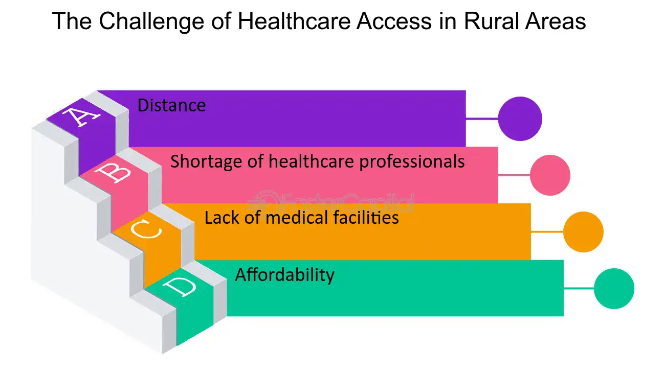

Slide 6
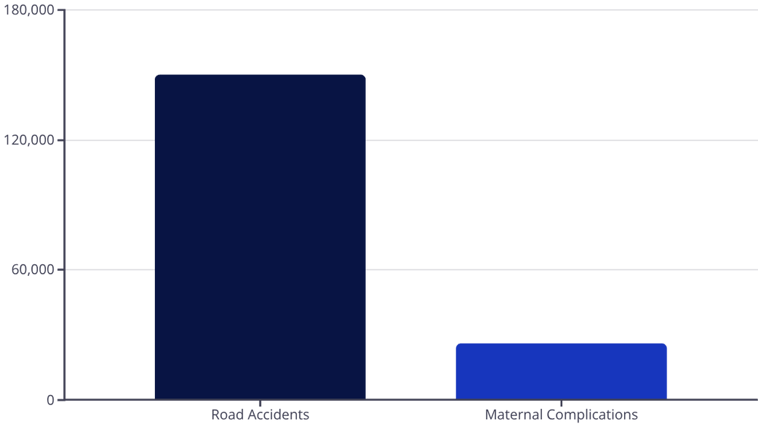
The Alarming Reality: The Cost of Delayed Care
The 'Hospital On Wheels' (HOW) directly confronts the tragic human cost of inaccessible and delayed medical attention.
A Crisis of Preventable Loss
India faces a severe challenge with high rates of mortality from conditions that are treatable with timely intervention. For instance, road accidents tragically claim around 150,000 lives annually, with many fatalities occurring due to delays in reaching medical facilities within the crucial 'Golden Hour'. These are not just numbers; they represent families torn apart and immense societal loss.
Similarly, the maternal mortality rate, though improving, still sees thousands of women lose their lives each year due to complications during pregnancy and childbirth – approximately one woman every 20 minutes. The lack of immediate, quality care in remote or underserved areas is a significant contributor to these heartbreaking statistics.
Notes:
16

Slide 7

What’s the Solution

Slide 8

Solution IS.....

Slide 9

HOW
(Hospital on Wheels )

Slide 10
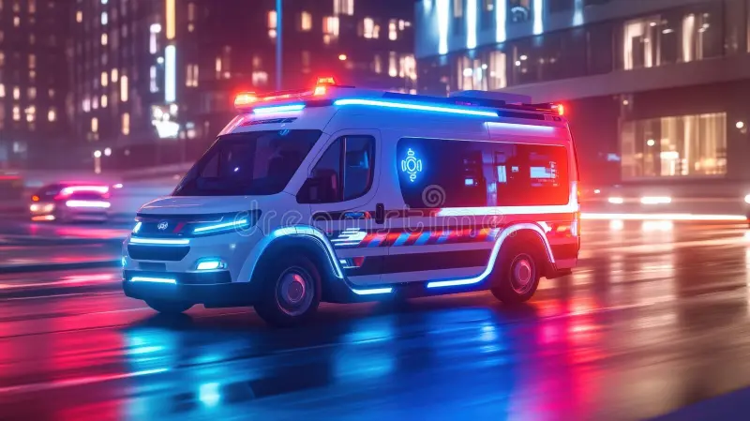
What HOW (Hospital on Wheels) Really is ?
🚑 A mobile medical unit delivering healthcare services to remote areas.
🏥 Functions like a small hospital on the move, equipped with essential tools
👩‍⚕️ Staffed with qualified healthcare professionals.
🧪 Provides diagnostics, minor treatments, and consultations.
💉 Offers immunizations, maternal care, and chronic disease management.
📡 Can include telemedicine for specialist support.
🕒 Operates on scheduled routes or during emergencies/disasters.
🌍 Aims to make healthcare accessible in underserved regions.

Slide 11
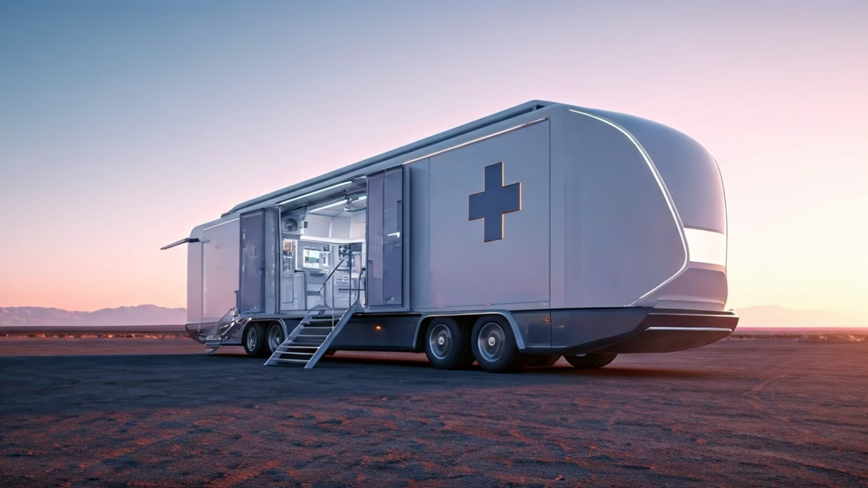




Real-life Use Cases
The versatility of the 'Hospital On Wheels' (HOW) model extends beyond routine healthcare, making it an invaluable asset in various critical real-life scenarios.
Pandemic Preparedness
Disaster Relief & Recovery
Mass Gathering Medical Support
During health crises like COVID-19, 'HOW' can swiftly transform into mobile isolation wards, rapid vaccination centers, or large-scale testing facilities, extending reach to underserved populations.
Its mobility allows for quick deployment to areas devastated by natural disasters such as floods, earthquakes, or cyclones, providing immediate medical aid and stabilising critical patients on-site.
'HOW' can provide essential on-site medical coverage for large public gatherings, including religious festivals, sporting events, or cultural celebrations, ensuring immediate access to care for attendees.
Notes:
14

Slide 12



Key Features of 'HOW'
The 'Hospital On Wheels' is more than just a vehicle; it's a meticulously designed mobile medical unit, fully equipped to handle a wide range of medical needs and mirroring the capabilities of a smaller static clinic.
Advanced Diagnostic Capabilities
Comprehensive Medical Stock
Operation Theater
Portable Ultrasound
Life-saving medications, including anesthesia, pain relief, Epipen or Adrenaclick and resuscitation drugs.
Heart rate monitor, ECG, and oxygen level monitors.
ECG machine
Pulse Oxymeter
Defibrillator
Blood Bank(O- , O+ , AB+)
Adjustable operation table with surgical lights and essential medical equipment(scalpels, forceps, and clamps are often organized and transported in portable kits. )
Essential first-aid and emergency kits.
Sterile environment for minor procedures.
Notes:
2

Slide 13
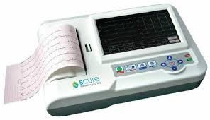
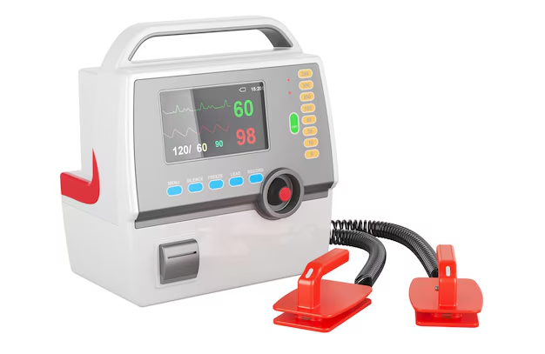
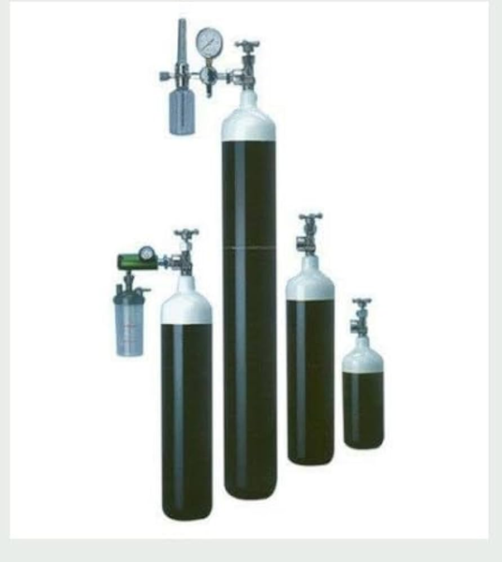
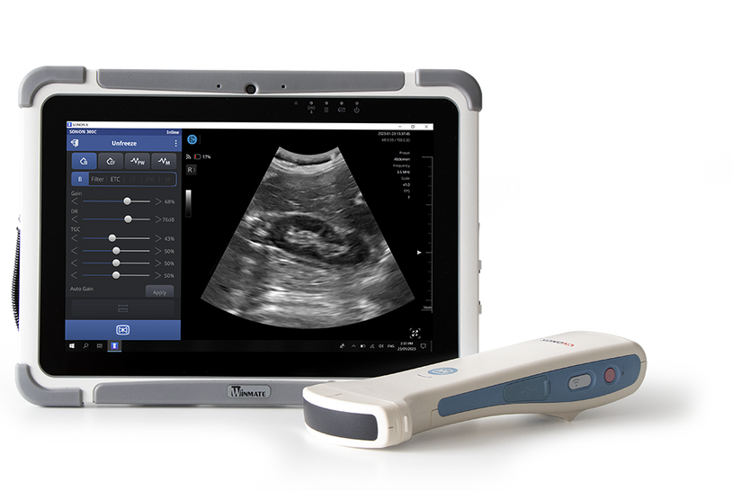
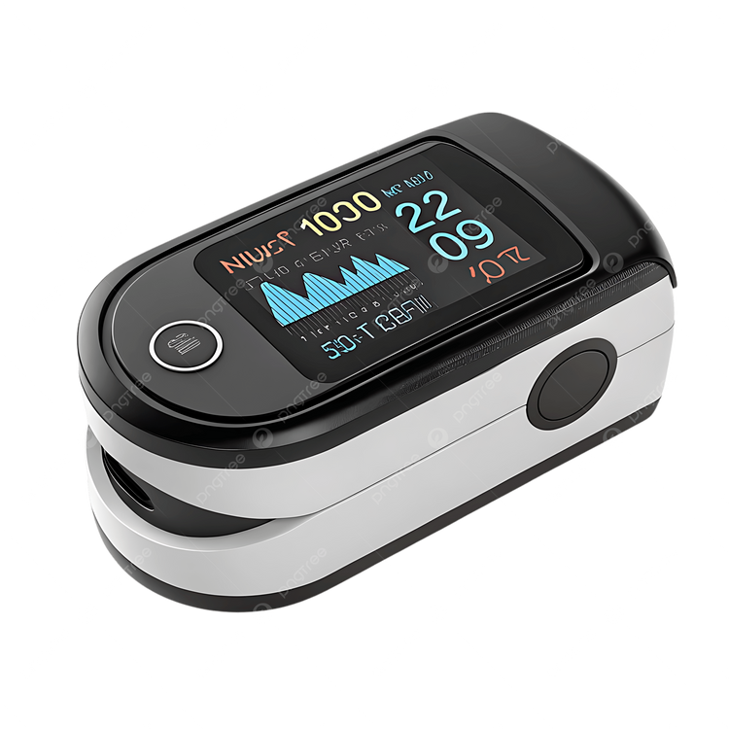
Electrocardiogram(ECG)
Defibrillator
D-Type Oxygen Cylinder
Ultasound Machine
PulseOxymeter

Slide 14

Immense Need for HOW
Every day, precious lives are tragically cut short, not by the severity of their conditions, but by the sheer inability of timely medical assistance to reach them. The 'Hospital On Wheels' (HOW) is not just an innovation; it's a desperate necessity to bridge this fatal gap.
Traffic Jams
Even in cities, we see cases where traffic jams delay ambulances. HOW, stationed at different locations, could directly reach patients instead of making them travel long distances
Notes:
13

Slide 15

Maternal Mortality in Childbirth
One woman dies every 20 minutes in India from pregnancy issues; timely help could save lives.Imagine if HOW could reach them—it could save two lives at once, both mother and child.

Slide 16

Emergency Illness
In many cases, 5-10 minutes decide survival, but ambulances only transport patients—they don't treat. Sometimes even severe cases need a simple short treatment. HOW can give instant medical care instead of just carrying the patient.

Slide 17

Accident Fatality
Road accidents in India cause about 1.5 lakh deaths annually, often due to delays in treatment during the 'Golden Hour. 'HOW, with its operation theatre and emergency facilities, can treat them immediately and reduce these deaths.

Slide 18
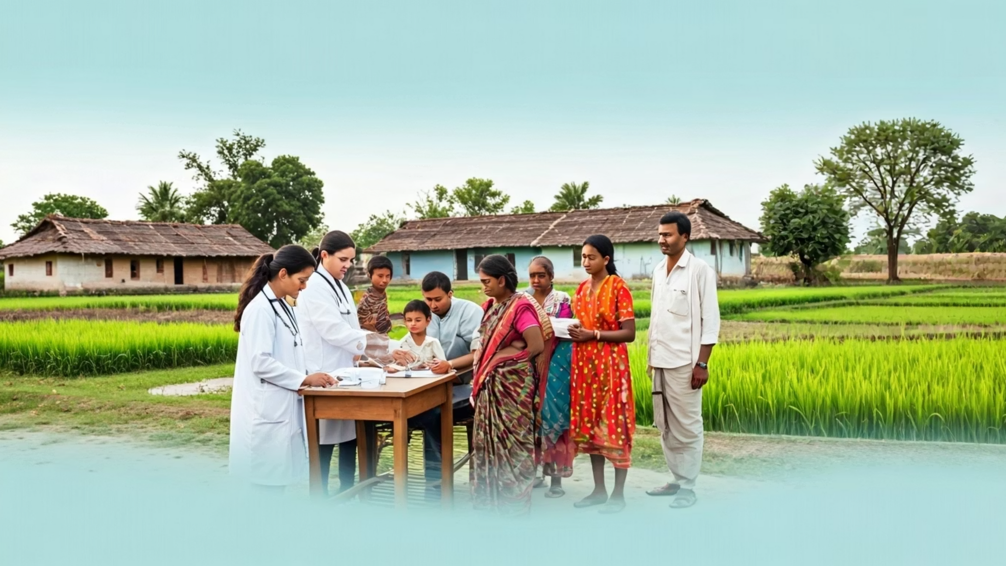


Empowering Communities
'HOW' doesn't just treat illnesses; it builds trust and empowers communities by making healthcare a right, not a privilege, fostering resilience and well-being for all.
Notes:
20

Slide 19

A Lifeline for Pregnant Women
Maternal and infant mortality rates remain a critical concern in many parts of India, largely due to lack of access to regular prenatal care and safe delivery facilities.
1
Regular Antenatal Check-ups
Providing routine check-ups, blood pressure monitoring, and fetal health assessments right at their doorstep. This eliminates the need for arduous and often costly travel to distant hospitals, making consistent care a reality.
2
Nutritional Guidance & Supplements
Educating expectant mothers on proper nutrition and distributing essential supplements like iron and folic acid to prevent common deficiencies that can harm both mother and child.
3
Early Detection of Complications
Equipped with basic ultrasound, 'HOW' can identify potential complications early, enabling timely intervention or safe transport to a larger facility if needed.
Notes:
6

Slide 20
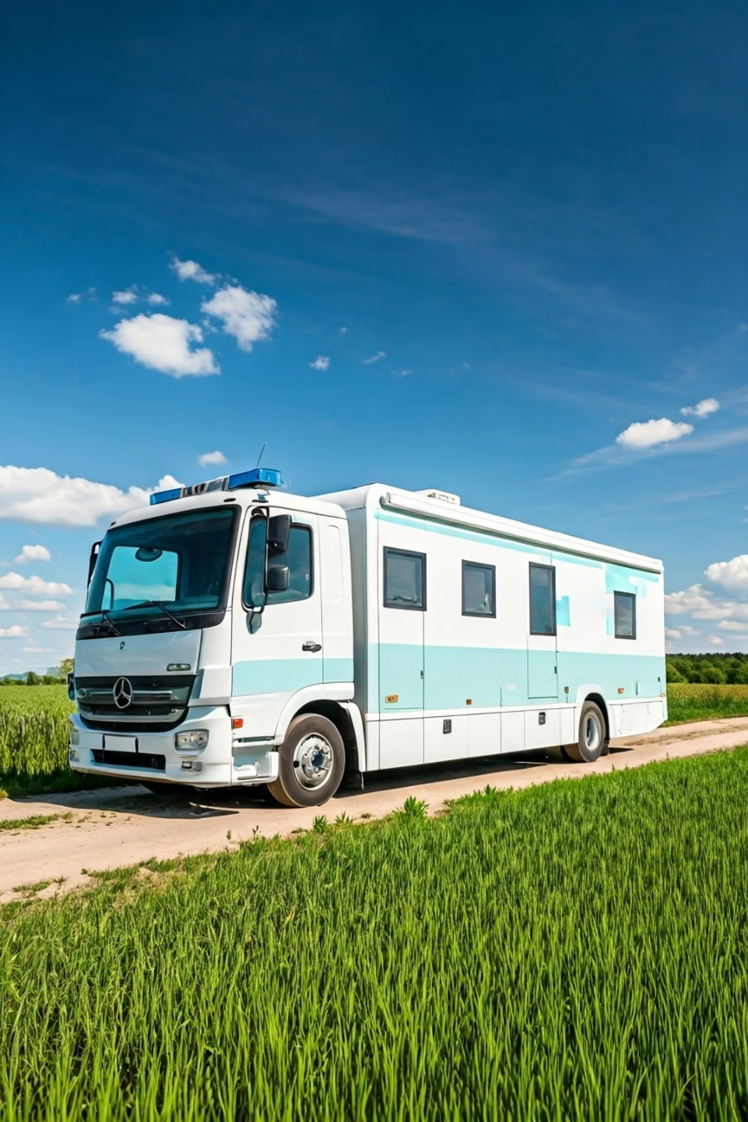
The HOW Model: Engineered for Resilience
The 'Hospital On Wheels' (HOW) is more than just a vehicle; it's a meticulously designed mobile healthcare unit, built to deliver advanced medical care in the most challenging environments.
Advanced Medical Suite
Equipped with state-of-the-art diagnostic tools, emergency resuscitation equipment, and a sterile minor surgery theatre, HOW ensures comprehensive care on the go.
Hybrid Power & Efficiency
Utilising a robust hybrid diesel-electric propulsion system, HOW maximises fuel efficiency and extends operational range, crucial for remote deployments.
Rugged Durability
Constructed with a reinforced chassis and all-terrain suspension, HOW is engineered to withstand diverse Indian topographies, ensuring reliable service delivery.
Integrated Solar Power
On-board solar panels supplement power needs, reducing reliance on external energy sources and ensuring continuous operation of critical medical equipment.
This thoughtful engineering ensures HOW stands ready as a beacon of health, transforming healthcare accessibility across India.
Notes:
17

Slide 21
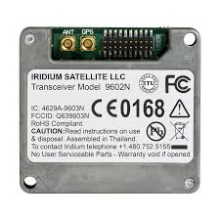

Technological Backbone: Communication & Connectivity
'HOW' integrates state-of-the-art communication technologies to ensure seamless interaction, real-time data exchange, and constant connectivity with central medical facilities and specialists, regardless of its location.
Satellite & Cellular Connectivity
Equipped with both satellite(Iridium satellite) internet and advanced cellular boosters, ensuring internet access even in areas with poor network coverage for telemedicine and data uploads.
Notes:
7

Slide 22
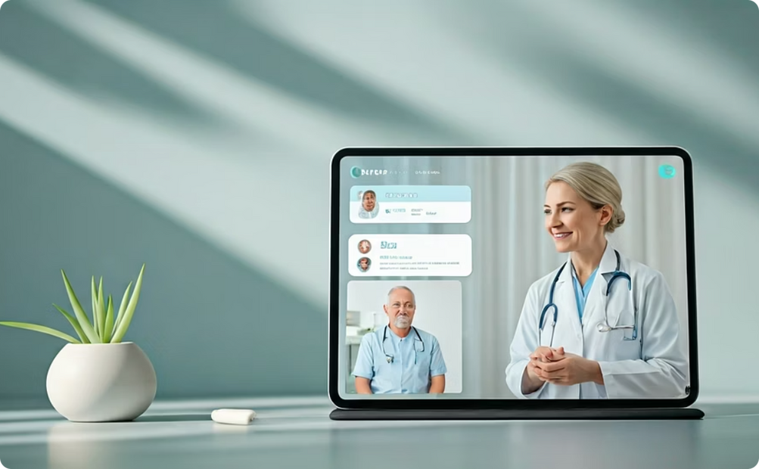
Integrated Telemedicine Platform
A secure, encrypted platform for video consultations with urban specialists, allowing for expert opinions on complex cases without patient travel.
Notes:
7

Slide 23

Electronic Health Records (EHR)
Patients' medical histories, diagnoses, and treatment plans are digitally recorded and securely transmitted, ensuring continuity of care and easy access for follow-up appointments.
Notes:
7

Slide 24



The Vision: Bridging the Healthcare Gap
'HOW: Hospital On Wheels,' is designed to address this critical disparity by bringing essential medical services directly to the communities that need them most. A fully equipped, modern medical facility capable of navigating varied terrains, providing immediate care, and connecting patients to advanced medical resources.
Accessibility
Equity
Sustainability
Breaking down geographical barriers to healthcare.
Ensuring everyone has a fair chance at good health, regardless of location.
A long-term solution for continuous, adaptable medical support.
Notes:
4

Slide 25
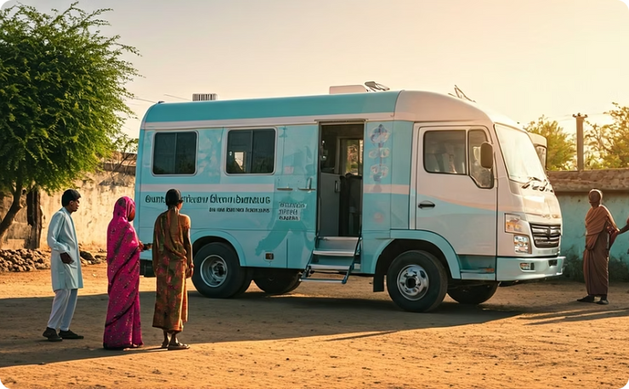
'HOW' and Sustainable Development Goals
The 'Hospital On Wheels' (HOW) initiative significantly contributes to sustainable development by addressing critical healthcare challenges through innovative and responsible practices.
Affordable & Accessible Healthcare
'HOW' reduces barriers to access by bringing services directly to underserved areas, lowering patient travel costs and offering economical medical solutions, fostering health equity.
Notes:
15

Slide 26
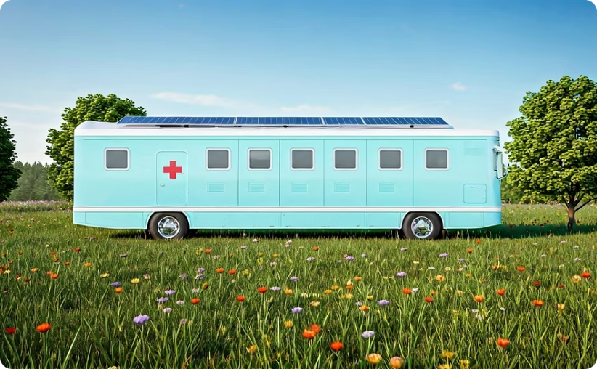
Green Technology & Sustainability
Designed with energy efficiency in mind, 'HOW' can integrate solar power for equipment and lighting, minimising its environmental footprint and promoting sustainable energy use in healthcare delivery.
Notes:
15

Slide 27
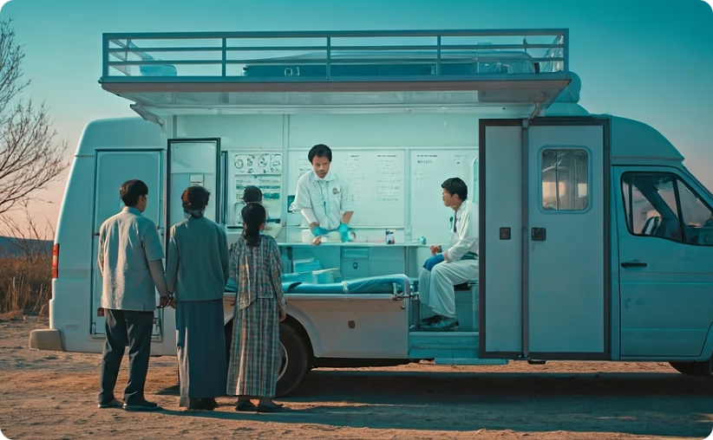
Time-Saving & Rapid Response
By providing immediate on-site diagnosis and treatment, 'HOW' drastically cuts down patient waiting and travel times, ensuring swift intervention, especially in emergencies, and improving health outcomes.
Notes:
15

Slide 28
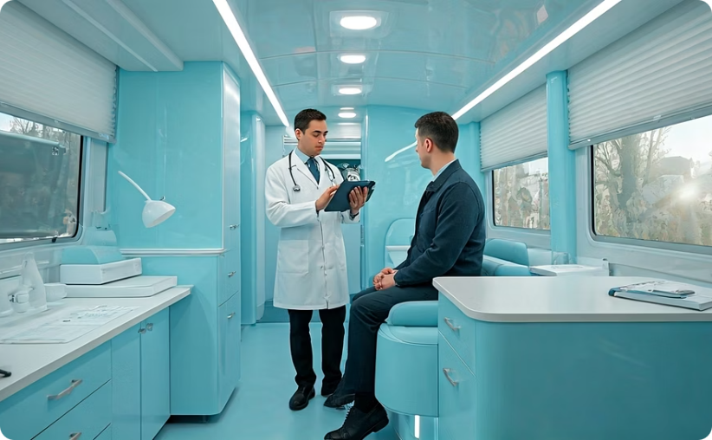
Enhanced Communication & Connectivity
Equipped with telemedicine capabilities and digital health record systems, 'HOW' bridges communication gaps, connecting remote patients with specialists and facilitating real-time data exchange for better public health management.
Notes:
15

Slide 29




Sustainability & Scalability
The 'Hospital On Wheels' project is envisioned as a long-term, scalable solution. Its design incorporates principles of sustainable operation and adaptability, allowing it to evolve with changing healthcare needs and expand its reach across different regions.
Community Integration
1
Working with local leaders and health workers to build trust and ensure acceptance, making the service truly community-driven and sustainable.
Cost-Effectiveness
2
Compared to building new hospitals in remote areas, mobile units offer a significantly more cost-effective way to provide extensive healthcare services.
Modular Design
3
The internal layout is flexible, allowing for future modifications or specialized modules (e.g., dedicated dental unit, eye care unit) to be added based on specific regional needs.
Public-Private Partnerships
4
Funding and operational sustainability can be achieved through collaborations between government health initiatives, NGOs, and corporate social responsibility (CSR) programs.
Notes:
8

Slide 30


Community Integration
Community integration refers to the full and equitable participation of all individuals, especially those with disabilities or who are marginalized, in the social, economic, and cultural life of their community, fostering independence, relationships, and belonging

Slide 31


Cost-Effectiveness
Cost-effectiveness refers to achieving the greatest benefit for a given cost or using the minimum resources to achieve a desired outcome.

Slide 32
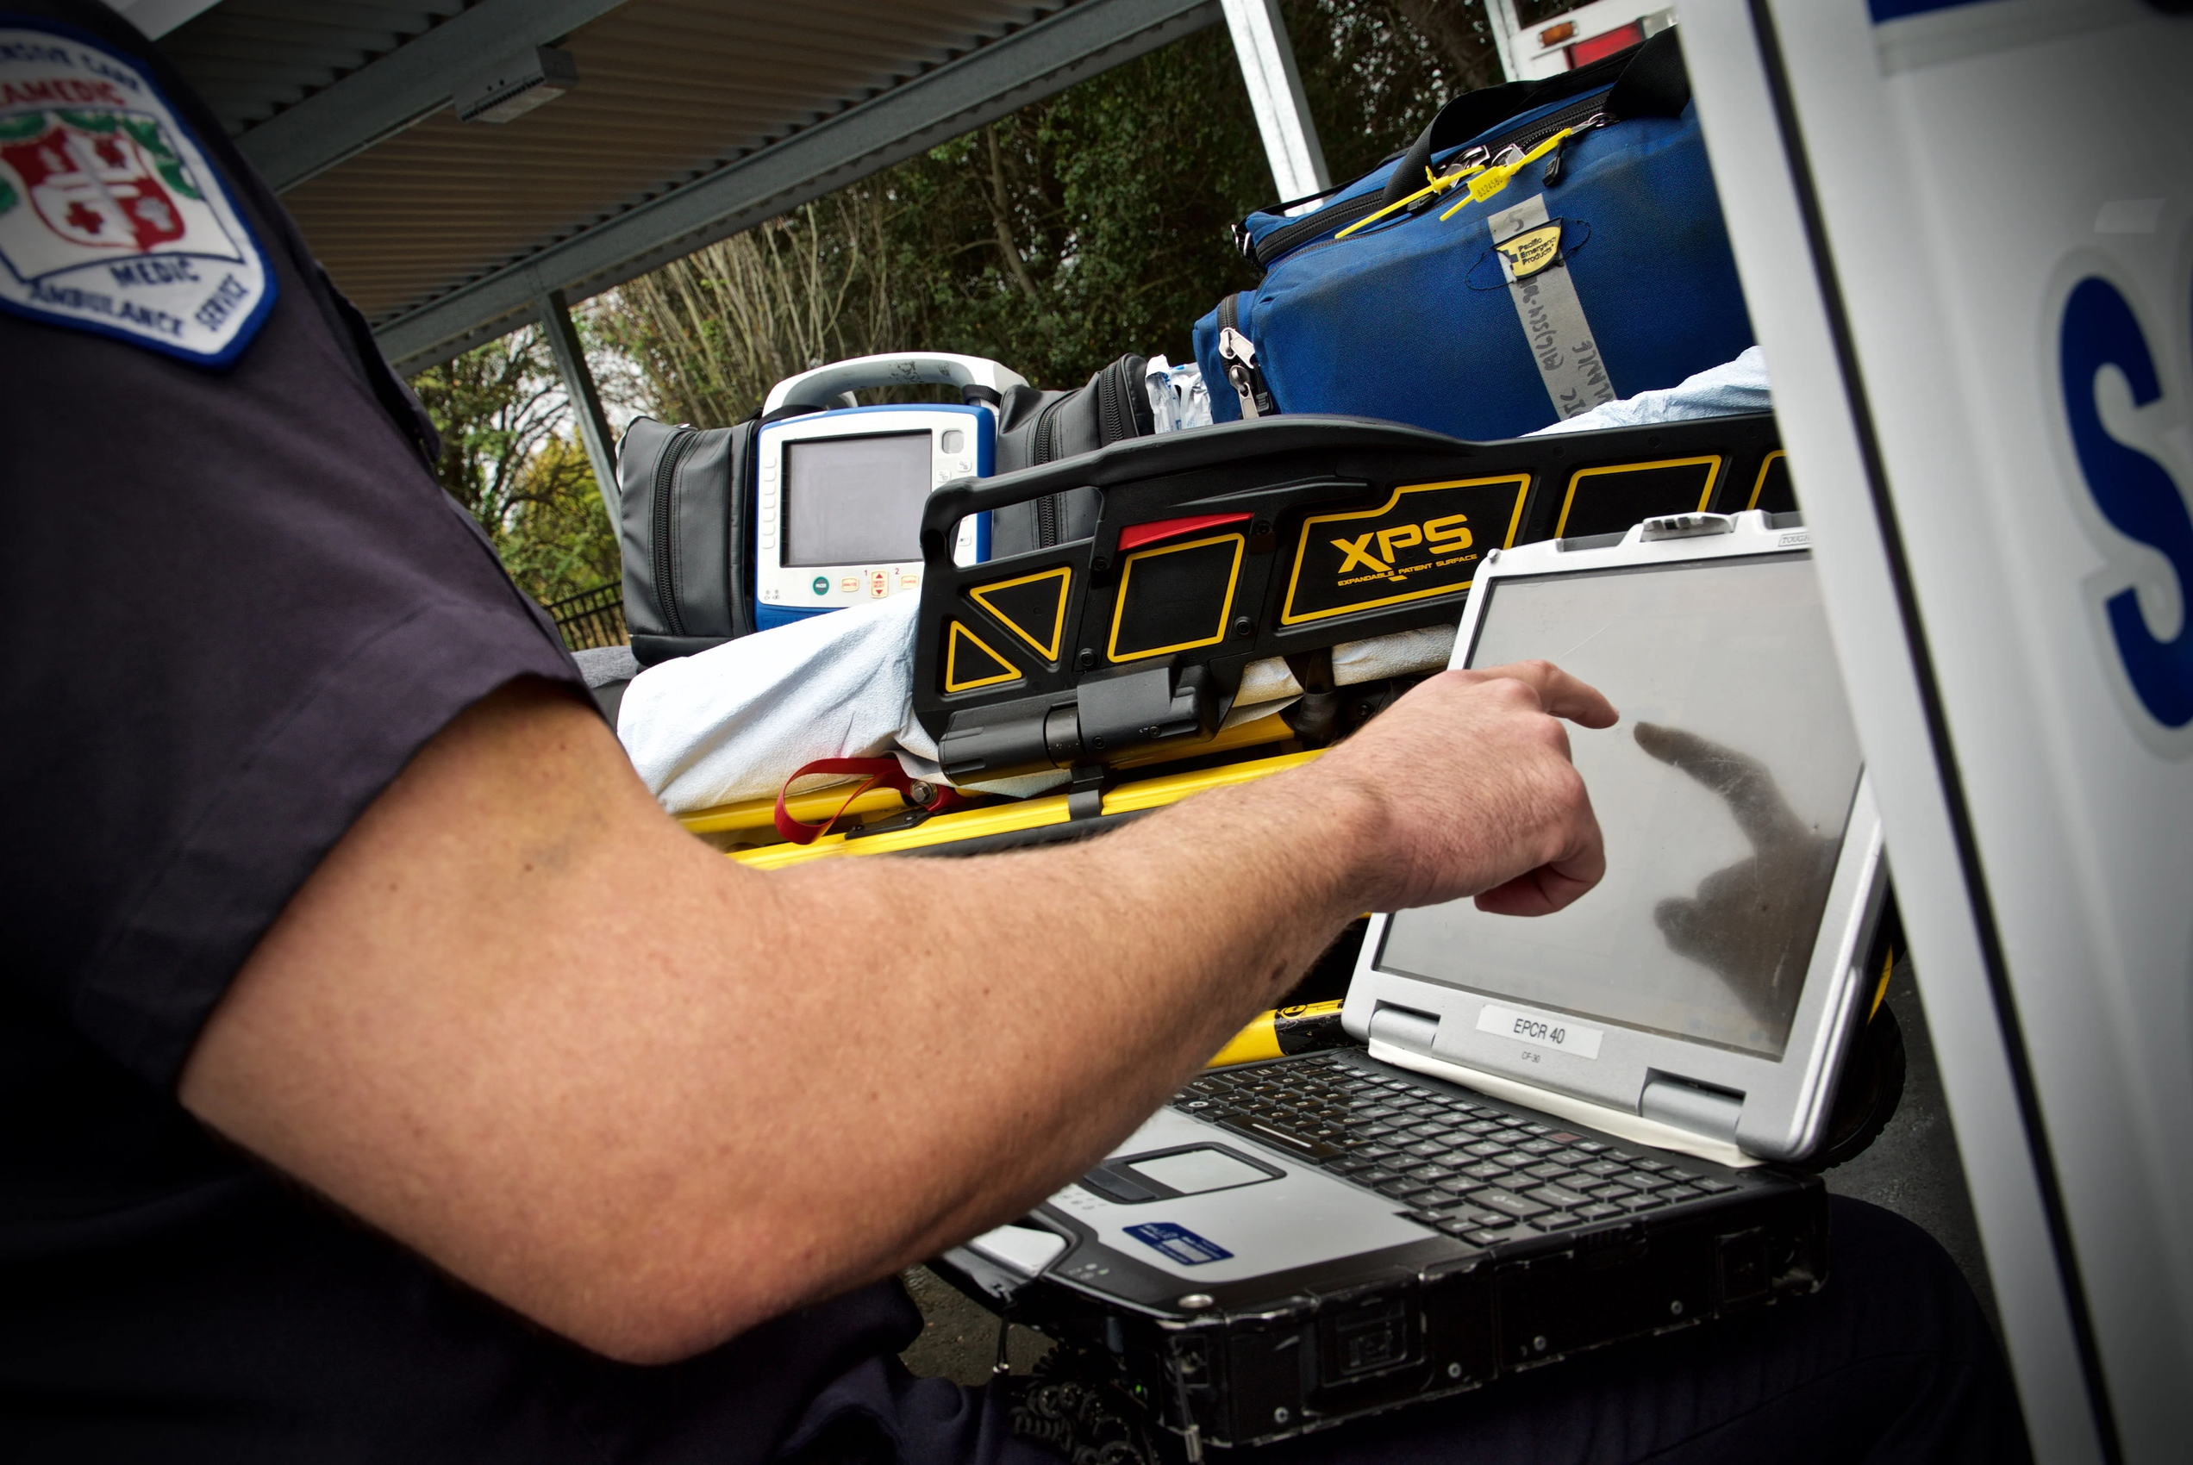
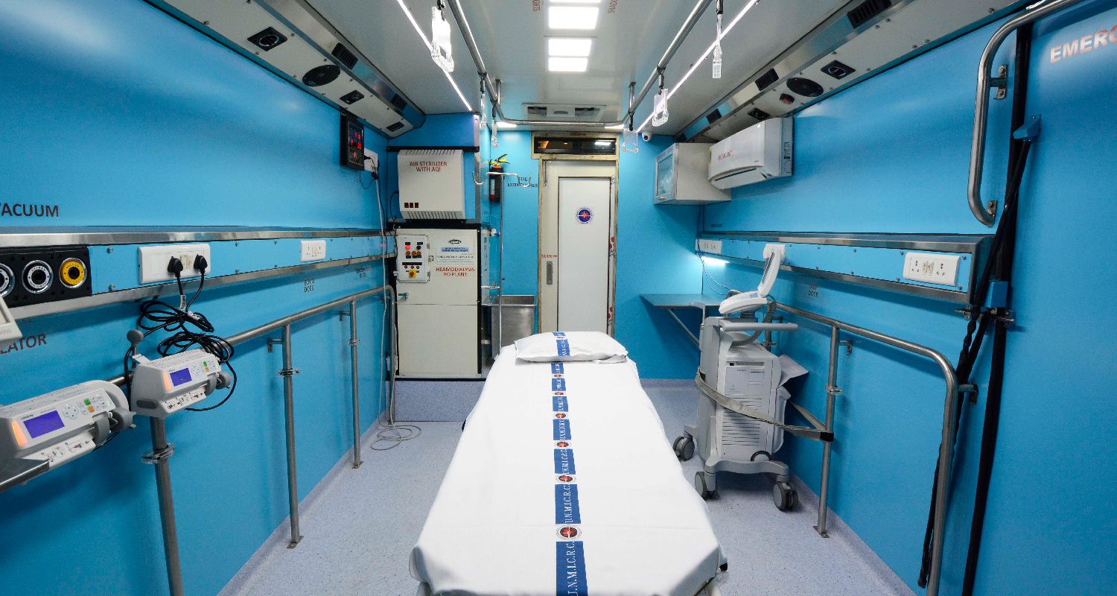
Modular Design
Modular design is an approach that breaks down a complex system into smaller, independent components, or "modules," which can be created, modified, and replaced individually

Slide 33

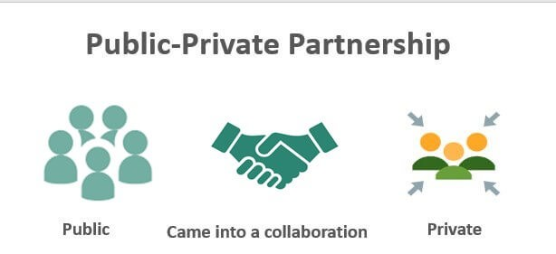
Public-Private Partnerships
is a long-term arrangement between a government and a private sector entity to finance, develop, and operate public infrastructure and services, sharing both the risks and rewards of the project

Slide 34
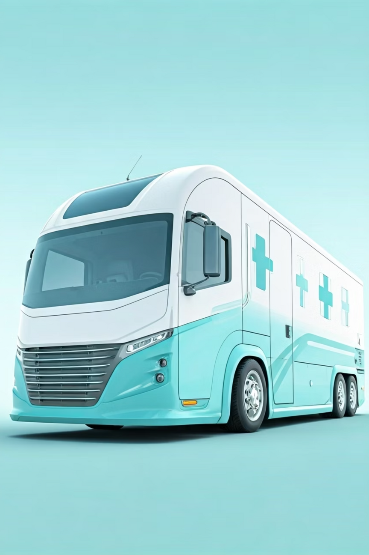



Future Enhancements
To further bolster the effectiveness and safety of the 'Hospital On Wheels' (HOW) model, several key enhancements are planned to integrate advanced communication and safety protocols.
Centralised Call Centres
Government-authorised call centres will be established to streamline coordination, manage emergency dispatch, and provide initial tele-consultations for specific regions, ensuring swift and efficient access to 'HOW' services.
Autonomous Accident Reporting
Each 'HOW' unit will be equipped with an advanced in-built accident detection system that automatically transmits distress signals and location data to a central monitoring unit in the event of an unforeseen incident, ensuring immediate response and personnel safety.
Community Awareness Programs
Future initiatives will include dedicated awareness campaigns to educate remote communities on the benefits and accessibility of 'HOW' services, promoting preventive healthcare practices and ensuring optimal utilization of the mobile units.
Notes:
11

Slide 35
Thank you.
Notes:
5

